Slide 1
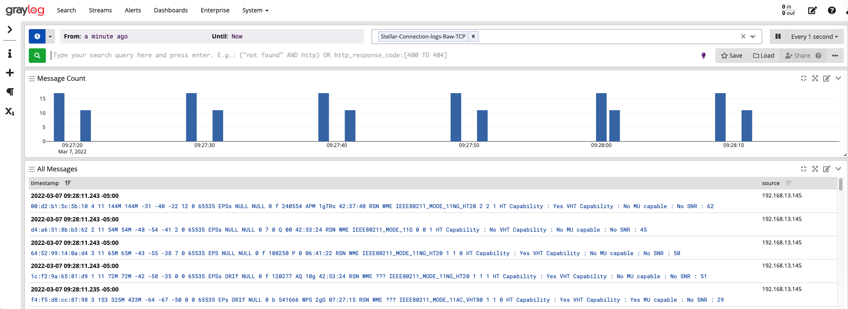
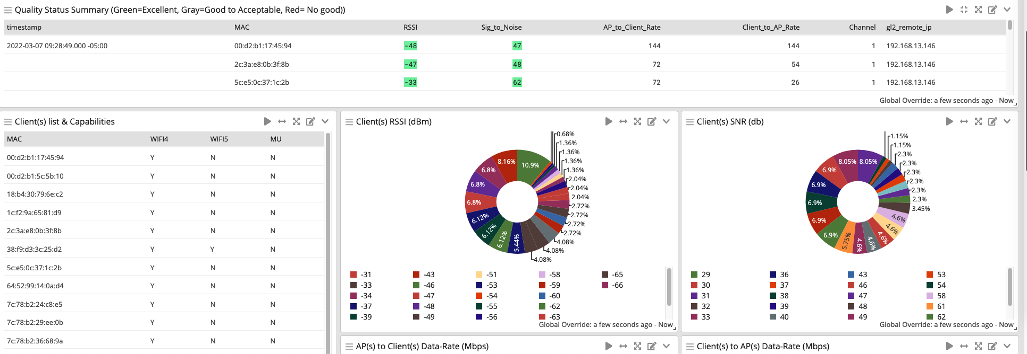
Stellar Domain
Log Management Domain
Graylog
Script
crontab
nc 172.20.0.4 5555
5555
* * * * * ( /root/signal-to-graylog.sh )
* * * * * ( sleep 10 ; /root/signal-to-graylog.sh )
* * * * * ( sleep 20 ; /root/signal-to-graylog.sh )
* * * * * ( sleep 30 ; /root/signal-to-graylog.sh )
* * * * * ( sleep 40 ; /root/signal-to-graylog.sh )
* * * * * ( sleep 50 ; /root/signal-to-graylog.sh )
Extractors
Indice
cat /tmp/log/lbd.log | grep bandmonCmnDetermineOperatingRegion | tail -2 | nc 172.20.0.4 5555
wlanconfig ath11 list | grep '65535\|SNR\|Capability\|capable' | awk '{ printf "%s", $0; if (NR % 5 == 0) print ""; else printf " " }' | nc 172.20.0.4 5555
wlanconfig ath01 list | grep '65535\|SNR\|Capability\|capable' | awk '{ printf "%s", $0; if (NR % 5 == 0) print ""; else printf " " }' | nc 172.20.0.4 5555
wlanconfig ath02 list | grep '65535\|SNR\|Capability\|capable' | awk '{ printf "%s", $0; if (NR % 5 == 0) print ""; else printf " " }' | nc 172.20.0.4 5555
Stream

Slide 2
Signal Analysis command output formatting
wlanconfig ath11 list | grep '65535\|SNR\|Capability\|capable' | awk '{ printf "%s", $0; if (NR % 5 == 0) print ""; else printf " " }' | nc 172.20.0.4 5555
Query the Atheros
driver on each SSID
Filter just the lines showing MAC, Channel #, RSSI, TX rate, RX rate, SNR, AP
Formatting the multi line output into one line
transmit the line to Graylog RAW-TCP INPUT port 5555

Slide 3
Create extractors, widgets and a Dashboard

